Slide 1

Product : PuddleSense
"Imagine having a personal road companion that not only captures the journey but also empowers you with real-time road insights. Introducing 'PuddleSense' , the daily road-scanning camera designed to keep you safe, informed, and ahead of the curve."

Slide 2

Identifying the Problem Statement
1
Unsafe Road Conditions in Rainy Weather
2
Lack of Real-Time Road Information
Rainy weather creates hazardous road conditions, endangering drivers.
Drivers lack real-time road condition data, leading to unexpected challenges.
3
Limited Awareness of Safe Routes
Drivers are unaware of safe routes during rainy seasons.

Slide 3
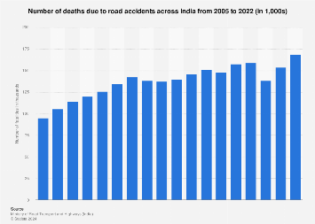
GRAPH : ACCIDENTS DUE TO POTHOLES
Trend: There is a noticeable upward trend in the number of road accident deaths over the years.
Early Years (2005-2010): The number of deaths gradually increases from around 90,000 in 2005 to approximately 130,000 by 2010.
Mid Period (2011-2016): The figures remain relatively stable, fluctuating between 130,000 to 150,000 deaths annually.
Recent Years (2017-2022): There is a slight decline in some years, but by 2022, the number of deaths rises again, reaching its peak at around 170,000.
Overall, the chart indicates a growing concern regarding road safety in India, with an increasing number of fatalities due to road accidents over the observed period.

Slide 4
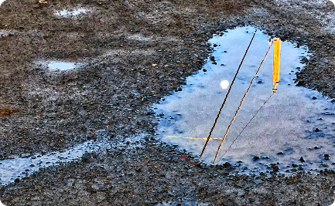

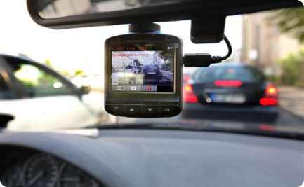
An Innovative Solution Overview
Daily Road Scanning:
Real-time Puddle Alerts:
Safe and Easy Installation:
PuddleSense scans the roads daily, creating a comprehensive database of road conditions.
Get instant alerts about puddle-prone areas during rainy weather.
Mounts easily on your car's windshield for hassle-free use.

Slide 5

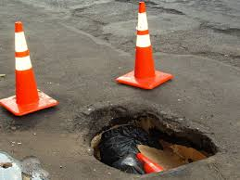

A website that tracks the number active potholes
and number of potholes that are fixed that can help
government resolve the pot hole problem and keep track
An Innovative Solution Overview
Accident detection system:
For faster maintaince:
Website that tracks no of active pothole:
Using the PuddleSense ,accident can be detected and a SOS is sent to the required authorities which can save lives
By integrating pothole detection data with traffic management systems, cities can better plan maintenance activities and manage traffic flow around problem areas.

Slide 6

Product or Service:
PuddleSense redefines the driving experience by addressing the persistent challenges posed by wet and unpredictable road conditions. Our state-of-the-art system scans the roads daily, offering drivers a vital edge with real-time environmental insights. Say goodbye to the uncertainty of puddle-prone areas and the hazards of rainy weather. PuddleSense stands as a dependable co-pilot, providing immediate alerts on puddles and guiding drivers on the safest routes. It's more than just a camera; it's your assurance for secure and confident travel, regardless of the weather outside."

Slide 7
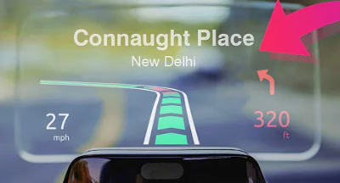
An Innovative Solution Overview
FEATURES OF PUDDLESENSE
HEADS UP DISPLAY : Heads up display with real time cautions.
Real-time detection : AI applications can identify potholes in real time.
High accuracy: Systems can use deep learning algorithms and computer vision to accurately detect and classify potholes.
Multiple camera support: Vision-based systems can use multiple cameras to capture images of the road surface
from different angles.
Visual cues: Some systems can provide highlighted visual cues to identify potholes.
Active base: Database that updates by itself if the required threshold is met

Slide 8

Targeted Audience
Commute and Daily Drivers: Individuals who commute to work, travel regularly, or drive daily and are looking for enhanced safety and convenience during their journeys.
Rainy Season Navigators: Drivers living in regions with frequent rain and inclement weather conditions, who face specific challenges during these periods.
Fleet Managers: Professionals responsible for managing vehicle fleets, who aim to improve driver safety, reduce maintenance costs, and ensure on-time deliveries, especially in challenging weather.

Slide 9

Conclusion:
"With 'PuddleSense,' you're not just driving; you're experiencing the road like never before. Say goodbye to unexpected puddles and hello to a safer, smarter way to travel. Don't just go, go with 'PuddleSense.'"

Slide 10

TECH STACK
HARDWARE
Hardware:Cameras: High-resolution cameras mounted on vehicles or drones to capture road images.
LIDAR: For depth perception and accurate mapping of potholes
GPS: To tag the location of potholes.
Accelerometers: To detect sudden jolts or vibrations that might indicate a pothole.Software:
Data Storage
Cloud Storage: For storing large amounts of image and sensor data.
Databases:SQL Databases: For structured data like pothole reports, user data, etc.
NoSQL Databases: For unstructured data like raw images and videos (e.g., MongoDB).
Data Preprocessing
Image Processing Libraries
OpenCV: For image preprocessing tasks like noise reduction, image enhancement, etc.
TensorFlow/Keras/PyTorch: For preparing data for machine learning models.
Data Augmentation Tools: To artificially increase the diversity of training data (e.g., Albumentations).
4. Machine Learning/Deep Learning Models
Model Frameworks:
TensorFlow/Keras: For building and training deep learning models.
PyTorch: Another popular framework for building neural networks.
YOLO: For real-time object detection.
ResNet/Inception: For image classification.
Computer Vision:
Convolutional Neural Networks (CNNs): For detecting and classifying potholes in images.
Object Detection Models: For locating potholes in images (e.g., Faster R-CNN, YOLO).
Edge Computing: For real-time processing on the device itself, reducing latency.

Slide 11
TECH STACK
User Interface
Web/Mobile Frontend:
React/Angular/Vue.js: For building the user interface.
Mobile App Development: Native (Swift, Kotlin) or cross-platform (Flutter, React Native) for mobile apps.
Visualization Tools:
Mapbox/Google Maps API: For displaying the location of detected potholes on a map.
Monitoring & Maintenance
Monitoring Tools:
Prometheus/Grafana: For monitoring model performance and system health.
ELK Stack (Elasticsearch, Logstash, Kibana): For log management and real-time analytics.
Model Retraining: Automation tools to retrain the model periodically as new data is collected.

Slide 12

Team Members
Anubhav Rawat (RA2311050010057)
Prakrut Dave (RA2311003010056)
Aditya Yaswardhan (RA2311003010070)
Rithvik Jaswal (RA2311003010040)
Nithin Krishna (RA2311003010049)

